Slide 1
2020 AP CS A Exam Exam Day Preparation

Slide 2
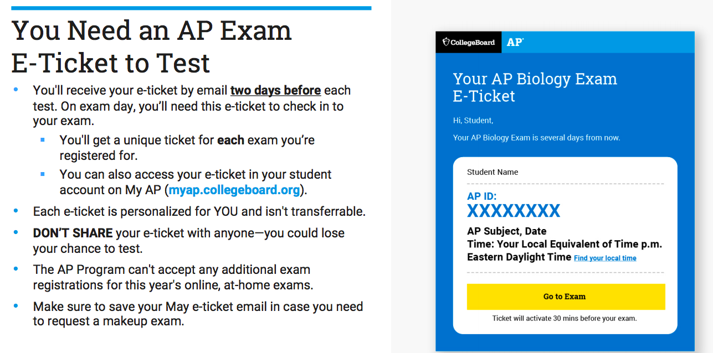

Slide 3
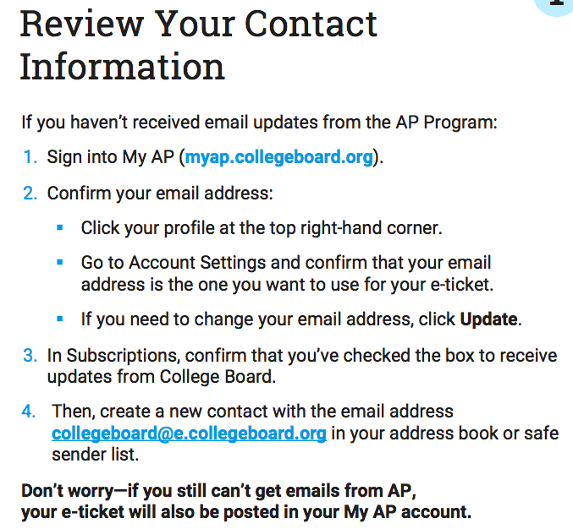

Slide 4
Exam Date
APCS A Exam Date: Friday, May 15 at 4PM Eastern Time.
Unless there's a significant conflict, students should test in May so they have the June dates as a backup if they have any disruptions.
If you can’t test on one of these dates, don’t use your e-ticket for that exam — you'll automatically receive a different e-ticket for makeup testing in June.

Slide 5
Exam Date
APCS A Exam Date: Friday, May 15 at 4PM Eastern Time.
If you have a conflict in May and don’t use your May e -ticket, you'll automatically receive a June e -ticket for that exam.
You'll also be able to request an e -ticket for June makeup dates if you have any disruption during your May exam.
You'll receive your makeup e-ticket two days before your exam. There are more exam conflicts in June, and no additional scheduled make - up dates after June 1 - 5, so test in May unless it’s not possible to do so.

Slide 6
Scores
It won’t be more difficult to earn a 3, 4, or 5 this year.
Even if an exam question seems more difficult to you than you expected, don’t worry—difficult questions require fewer points to earn 3s, 4s, and 5s than easier questions require.
So this year’s scores will be very similar to prior years’ scores. Just stay calm, read each part of the question, and simply show what you know and can do within the time you have.
AP Exams are never graded on a curve—and this year’s exams are no different. You’re not competing against any other students. There’s no maximum or minimum number of students who can receive a specific score. All students who earn the required points will get scores of 3, 4, or 5 this year.

Slide 7
Scores
Don't worry if you don't complete all parts of the question before you need to attach and submit your response.
To give students as many different chances to demonstrate what they know as possible, a question may have more parts than can be answered in the allowed time.
You don't need to complete the entire question to get a score of 5, but you do need to submit whatever work you've done.

Slide 8
Review Scores
Because creating a good testing environment at home is a challenge for some students, the exam is much shorter this year.
In a year when the exam provides you with fewer questions than usual to show the extent of what you learned this year, we want to ensure you have a fair opportunity to show what you know and earn college credit.
So AP teachers will have the chance to review your score and your exam responses this summer. If you don't receive a score of 3 or higher and your teacher is convinced you should have, your teacher will be able to engage with the AP Program's college faculty partners to review and confirm your score, ensuring it's fair and appropriate

Slide 9
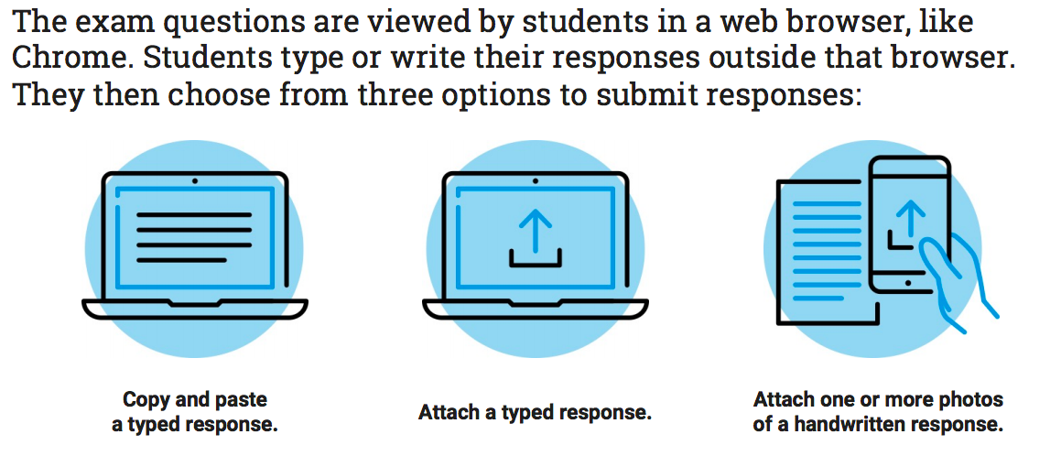
How to Upload Your Exam
We're confident that the vast majority of AP students will follow the rules for taking the exams.
For the small number of students who may try to gain an unfair advantage, we have a comprehensive and strict set of protocols in place to prevent and detect cheating.
While some of these practices are confidential to maximize their effectiveness, students and education professionals can learn more about our security measures.

Slide 10
Supported Browsers
Supported Browsers: Chrome (recommended), Firefox, Safari, or Edge
Note: Internet Explorer is NOT SUPPORTED!

Slide 11
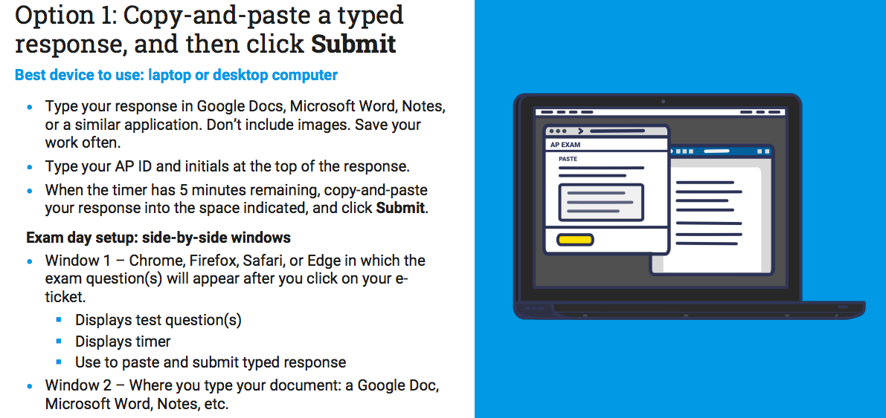
Option 1

Slide 12
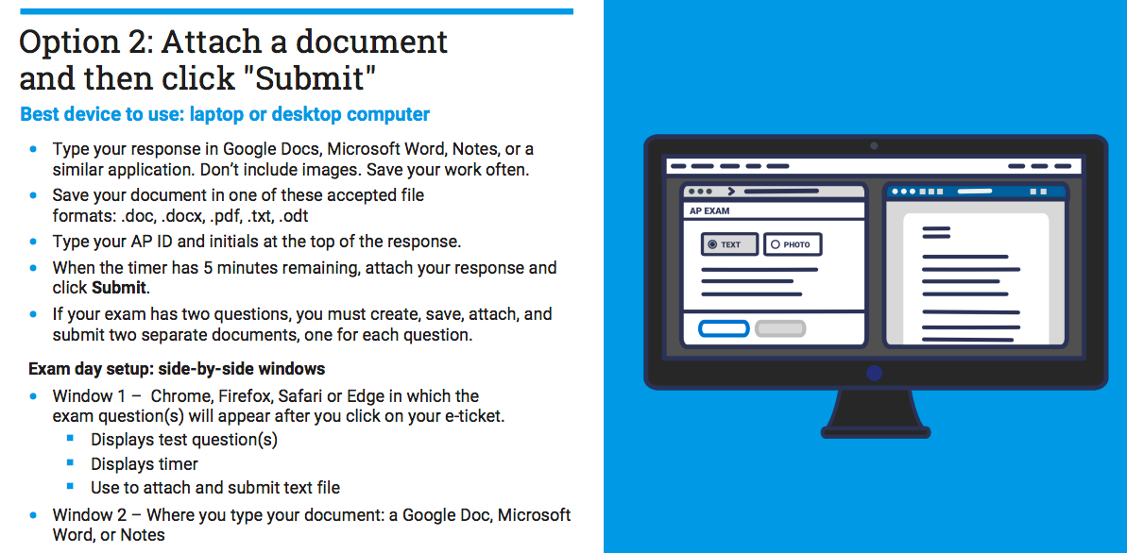
Option 2

Slide 13
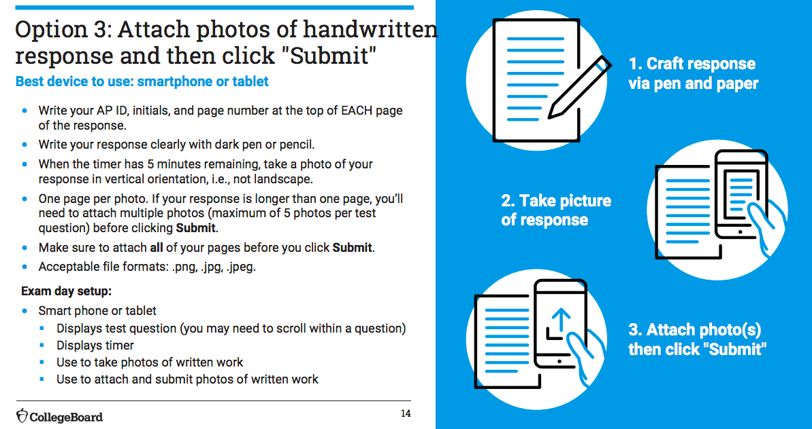
Option 3

Slide 14
Typing Your Response
Decide whether you'll be using Google Docs, Microsoft Word, Notes, or another application. Note that you cannot directly type into the web browser, You HAVE to copy and past or upload the file.
Note that Microsoft Word will have autocorrect feature, which can be annoying. I recommend using an unformatted basic text editor like NotePad(Window) or TextEdit(Mac) and change setting to "plain text".
It is recommended that your turn on auto-save or similar features.
If you’re using a cloud document, like Google Docs, and want to attach your document rather than copy-and-paste, remember that you’ll need to download your response in one of the approved formats (.doc, .docx, .pdf, .txt) and save it to your device.

Slide 15
Typing Your Response
You have to copy and paste or upload one question(including all of its parts, e.g. a), b) and c)) at a time.
If there is a mistake on the copy and paste, click on "Clear Field" and edit your original source code and then recopy and paste.
When you copy and paste, you should copied your AP ID, initials and your complete response to all parts of that one question.
If you click out of the window by mistake, go to your email or myap.collegeboard.org and click on your e-ticket to resume.

Slide 16
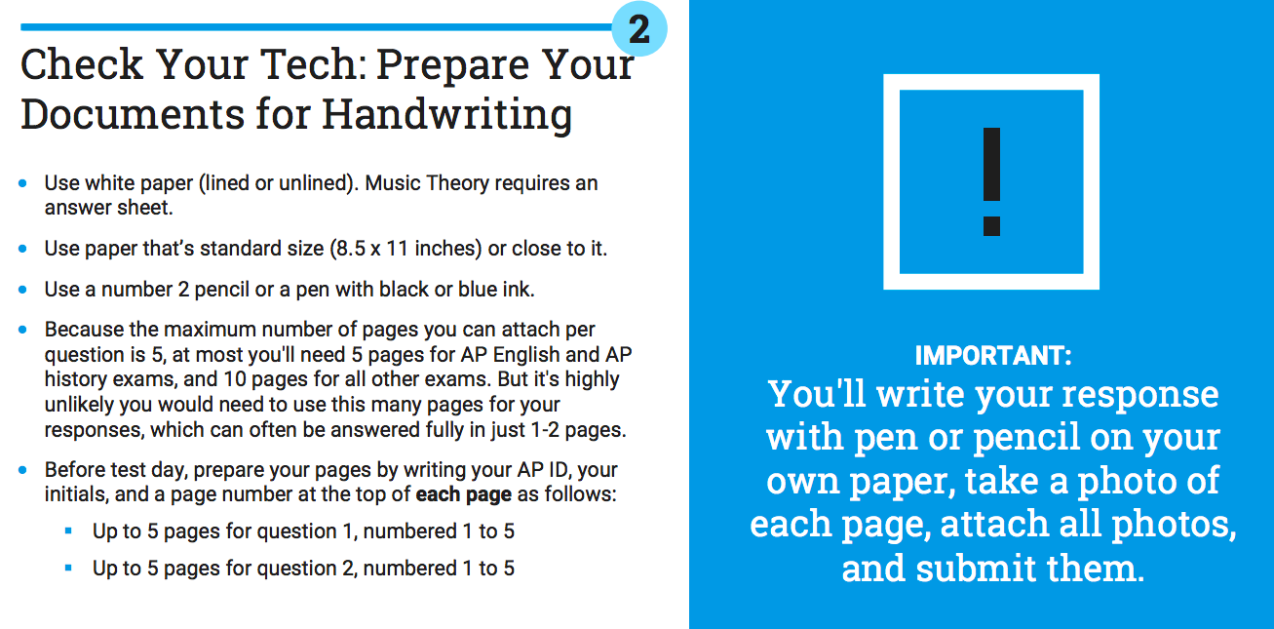
Handwriting Your Response

Slide 17
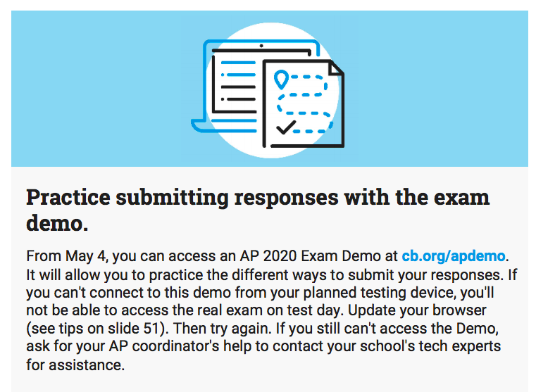
Practice Submitting Responses
Enter "PRACTICE" to access the demo.

